Slide 1
Practice Placement Allocations Office
Information Session 2023

Slide 2
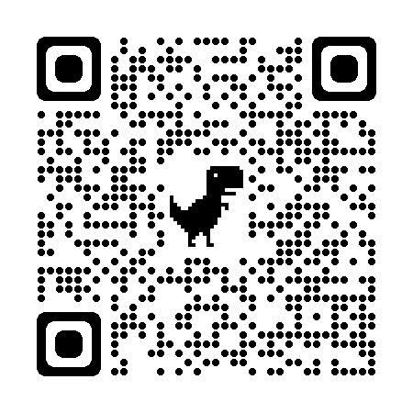
PPA Team
PPA Office
Bernie Maher, Louise Greene, Eimear Doherty & Susan Flood
Office located in Block C – Room 0.01 (behind Pulse Café)

Slide 3
Stage 1 Practice Placements
2 x core placements
5 weeks starting 15/01/2024 (provisional dates)
6 weeks starting 25/03/2024 (provisional dates)
Where can your Stage 1 placement occur?
SVHG: SVUH, SMH, St. Columcilles, Blackrock Clinic, Beacon Hospital or St. Vincent’s Private Hospital
MMUH: MMUH, Mater Private, Santry Sports Clinic, Cappagh or Clontarf Hospitals
SJOGH: SJOGH Hospital or Cluain Mhuire Community Services around Stillorgan/Dun Laoghaire
CHOE: Community Services as well as in-patient services between Clonskeagh, Elm Mount Unit in SVUH Campus or Newcastle Hospital and Community Services
CHI-SVUH: CHI Crumlin, Temple Street, Tallaght and Connolly (child) and SVUH (adult)
CHI-MMUH: CHI Crumlin, Temple Street, Tallaght and Connolly (child) MMUH (adult)
NMH: National Maternity Hospital and/or Wexford Maternity Unit, Kilkenny Maternity Unit, Mullingar Maternity Unit

Slide 4
Specialist Practice Placements
Occur in Stage 2 & 3 of your programme
Necessary to meet NMBI requirements
It is for this reason that students attend practice placements both in Dublin and also in other non-Dublin based IEHG clinical sites
Internship
Occur in Stage 4 of your programme
36 weeks in total

Slide 5
Garda Vetting
Two-part process:
UCD Student Vetting Application
NVB Vetting Application
Garda Vetting is a requirement for all nursing and midwifery students in order to attend practice placements
No vetting outcome = no practice placements, no exceptions
Students’ responsibility to regularly check the status of their application through the UCD vetting system

Slide 6
UCD Student Vetting Application rda Vetting
UCD Vetting - What do I need?
Certified copy of your photo ID: passport or driving license
Certified copy of your proof of address: CAO offer letter, bank statement, lease agreement
MUST be dated within the last 6 months
MUST match address on your NVB1 form
A certified copy of your documents is a copy of original documents stamped by any of the following authorities: Garda Siochana, Practising Chartered and Certified Public Accountants, Practising Solicitors, Embassy Staff, Justice of the Peace, Medical Doctor, UCD Student Desk or the PPA Allocations Office
Signed NVB1 form
Additional documents may re required:
Under 18 - parent/guardian consent form required NVB3 form
Lived overseas for more than 6 months since the age of 18 – Police Certificate(s)

Slide 7
NVB Vetting - What do I do?
Check email regularly for invitation from evetting.donotreply@garda.ie
As soon as it arrives log in and complete:
Previous addresses since birth
Any previous names you were also known as: maiden name, change of name etc
Passport number
NVB vetting can take 2-3 weeks
Check email regularly for result of outcome
If you require Police Certificate(s), vetting outcome is not released until the certificates are received

Slide 8
Register with NMBI
Step 1
Log into My.nmbi.ie
Choose “Create an Account”
Points to note:
Certified proof of ID is required – we will be hosting appointment only session to have your ID certified (details to follow)
29th September, 06th October, 13th October, 20th October and 27th October
Date of commencement will be 11 September 2023
€20 candidate registration fee payable to NMBI
Name on NMBI Candidate Register needs to be the same as your certified ID (passport)
Students not on NMBI Candidate Register will not be permitted to attend practice placements

Slide 9
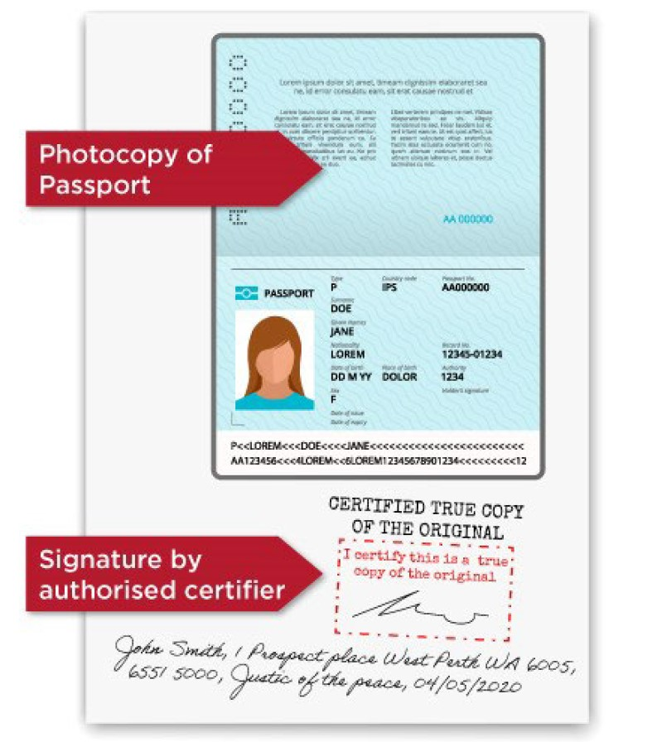
NMBI Certified ID
What ID is accepted? | Passport OR National Identity Card (non-Irish citizens)
How do I certify the ID? | The ID must be certified by a competent authority. They will be required to see the original document and a colour photocopy They must state their full name and profession and stamp, sign and date the colour photocopy of the document
The certifying authority must confirm they have seen the original document
Students must not sign the document themselves
An Garda Siochana maybe used to certify your document copy but only if it must be done exactly as per the image, any deviation will not be accepted by NMBI

Slide 10
Register with NMBI
Step 2
Following your account creation and uploading of certified ID, UCD will need to approve the application
Step 3
NMBI will then check application and certified ID
If not acceptable, the status will change to ‘Incomplete’
If acceptable, the status of the application will change to 'Provisionally Accepted'.
You will receive an email with a link to confirm the decision.
When you confirm, your application will be 'Accepted'.
You will be able to access your certificate in 'My Documents' (first go to 'My Account' and then select 'My Documents')

Slide 11
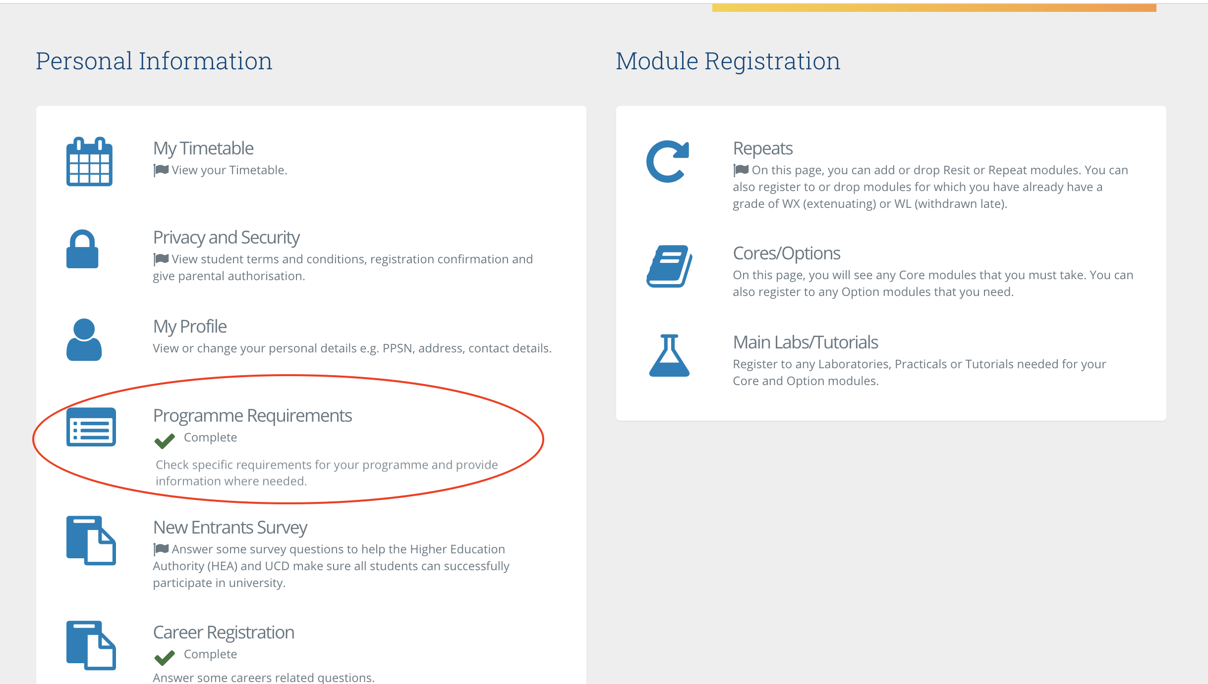
Programme Requirements
Required in order to be considered fully registered on the programme
Log into your SISweb account
Green tick means you have completed it

Slide 12
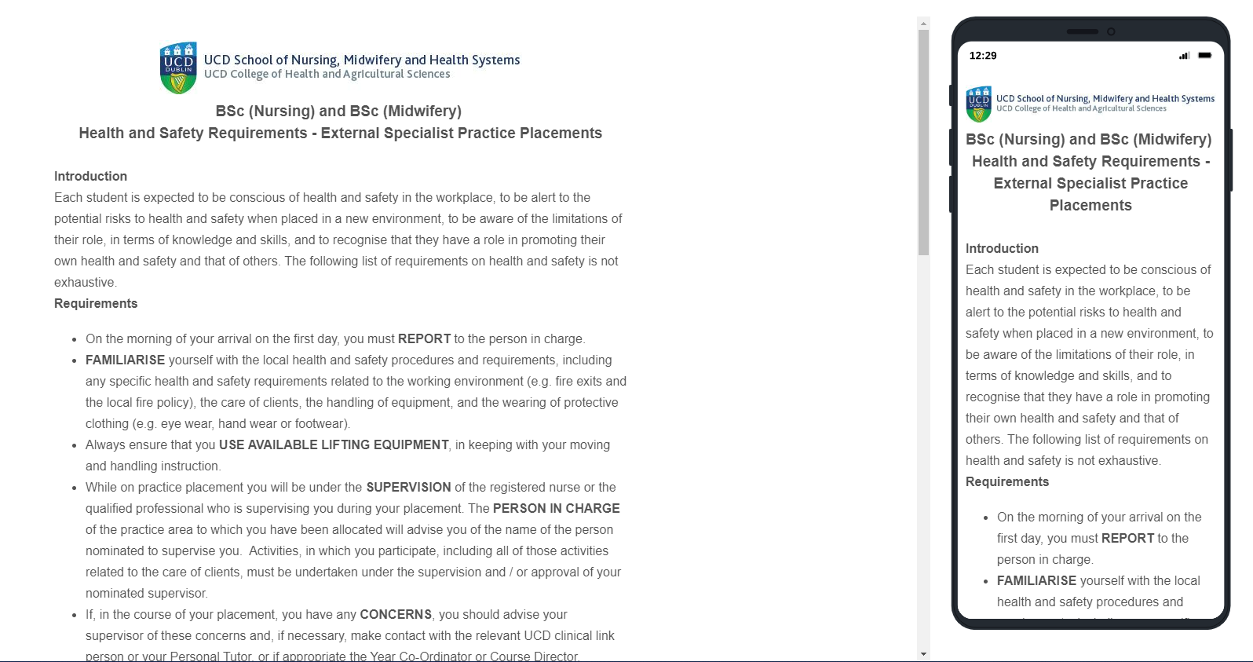
Health and Safety Requirements - External Specialist Practice Placements

Slide 13
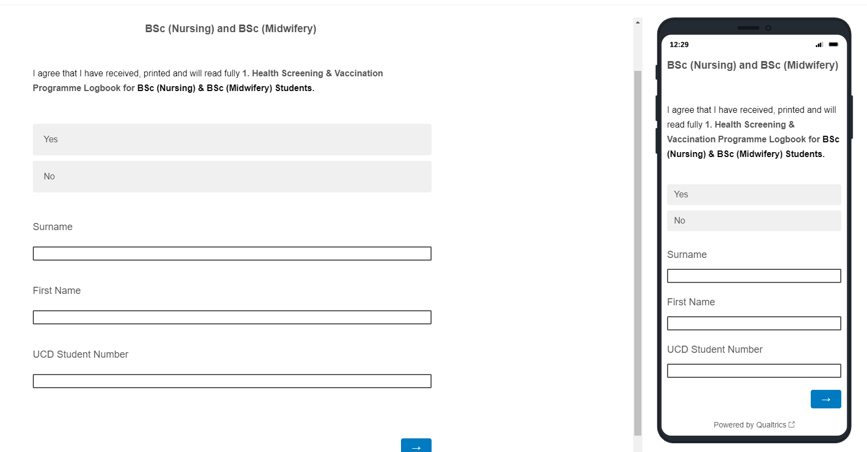
Vaccination Programme Logbook Receipt

Slide 14
Other Actions
Read thoroughly all orientation documentation
Complete and return any documentation as required by your parent hospital
Return to Occupational Health any required evidence of your immune status as required by your parent hospitals

Slide 15
Questions?
Contact us

